Slide 1





VIGNAN'S INSTITUTE OF ENGINEERING FOR WOMEN
Approved by AICTE &Affiliated to JNTUK
Department of Computer Science and Engineering
TRAFFIC SIGN DETECTION USING CONVOLUTIONAL NEURAL NETWORK
Under the Guidance of
Mrs. J. Himabindu
Assistant Professor
Team Members
P. Harshitha 16NM1A0586
P. Manasa 16NM1A0591
R. Sai Priya 16NM1A05A0
M. Joshna 16NM1A0575

Slide 2
TABLE OF CONTENTS
Abstract
Introduction
Existing System
Problems in Existing System
Proposed System
Analysis
Algorithm
Flow Chart
Design
UML Diagram
Implementation and Result
Conclusion

Slide 3

ABSTRACT
Traffic Sign Detection and Recognition (TSDR) plays a crucial role here by detecting and recognizing a symbol, thus notifying the driving force of any upcoming signs.
With the assistance of this Traffic Sign Detection System (TSDR), drivers will not face the problem of understanding what the sign says.

Slide 4
INTRODUCTION
Traffic sign detection is often considered a particular case of object-class detection. In object-class detection, the task is to seek out the locations and sizes of all objects in a picture that belongs to a given class.
However, many challenges remain for an unsuccessful system because the performance of those systems is greatly suffering from the surrounding conditions that affect the road sign visibility.

Slide 5
EXISTING SYSTEM
Traffic sign helps us to interpret the state of the road to regulate the traffic and also helps in a warning and guiding pedestrians and drivers.
Traffic sign detection algorithms specialize in the detection of traffic signs even from the damaged traffic signboards.
A combination of color and shape-based algorithm is presented which will used to detect and recognized by used SVM algorithm

Slide 6
PROBLEM IN EXISTING SYSTEM
Traffic sign detection system plays great potential in the decline of road accidents by alerting the driver in a complex scenario and unconscious driver due to many psychological factors.
Basically SVM algorithm is not suitable for large data sets. It doesn’t
perform very well when the data is large.

Slide 7
PROPOSED SYSTEM
Most of the sign detection methods consider detecting traffic signs with good lighting conditions.
Traffic Sign Detection and Recognition using image processing for the detection of a symbol and an Convolutional Neural Networks (CNN) for the recognition of the sign.
After performing the method of classification of a traffic sign, that output is transferred within the sort of speech.

Slide 8
ANALYSIS
SOFTWARE REQUIREMENT SPECIFICATION
Software Requirements
Operating system: Windows 10 Professional
Platform: Anaconda (Jupyter notebook)
Front end: Python
Backend: Tensor Flow
Hardware Requirements
Monitor: 17 VGA Colour
Processor: Intel core i5
Keyboard:110 keys enhanced

Slide 9
ALGORITHM
Step 1: Start
Step 2: Detects the traffic sign.
Step 3: Classifies the recognized sign.
Step 4: Fetch the information, regarding the sign.
Step 5: Information is displayed and turn out as audio.
Step 6: As a result, Driver receives information about sign.
Step 7: Stop

Slide 10
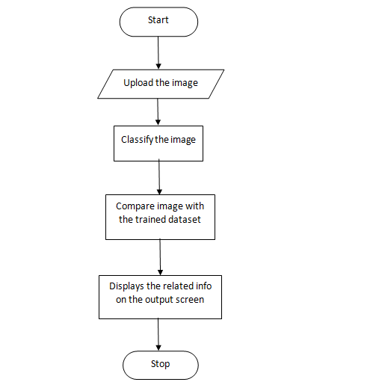
FLOW CHART
Figure 1: Flow Chart for Traffic Sign Detection System

Slide 11
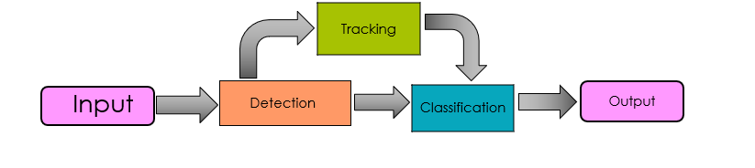
DESIGN
Figure 2: Design for Traffic Sign Detection System

Slide 12
In real-world, for Traffic Sign Detection and Recognition we use image processing for the detection of a symbol and an ensemble of Convolutional Neural Networks (CNN) for the recognition of the sign. Since CNN has a high recognition rate, it's used for implementing various computer vision tasks. For the implementation of CNN we generally use Tensor Flow.
After recognition of the traffic sign it is then convert the text to speech format . For text to speech conversion we are using Google Translation.

Slide 13
FOR CREATING A NEURAL NETWORK MODEL
Numpy
Numpy is a numerical processing with Python
Layers
Fully connected layers are defined using Dense class
Model
The sequential model is a linear stack of layers

Slide 14
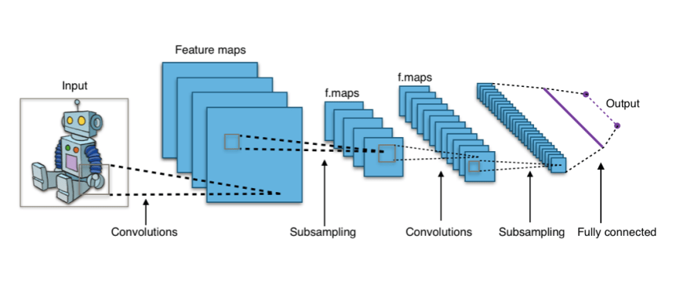
Convolutional Neural Networks
Convolutional Neural Networks may be a concrete case of deep learning neural networks. CNN is extremely like neural networks. They're forms by the fundamental units called NEURONS.
Figure 3: Convolutional Neural Network

Slide 15
Input Layer
The model expects rows of the data. It holds the images with width 32, height 32 and depth 3.
Activation Function
It determines the output of a deep learning model,its accuracy, and also the computational efficiency of training

Slide 16
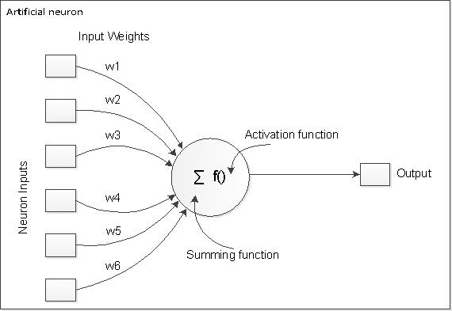
Types of Activation Functions
Linear
Sigmoid
Tanh
ReLU(Rectified Linear Units):
y = max(0, x)
Leaky ReLU
SoftMax
Figure 4: Activation Function

Slide 17
Hidden Layers
Input layer
Hidden layer
Output layer
Figure 5: Hidden Layers

Slide 18
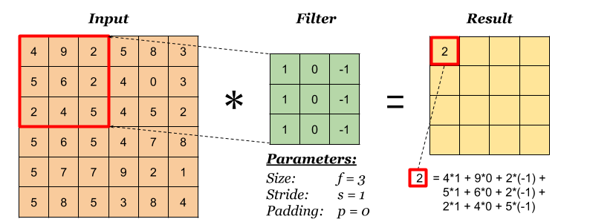
CONVOLUTION LAYER
Convolution is applied on input data using a convolution filter to produce a feature map
Figure 6: Formation of feature map

Slide 19
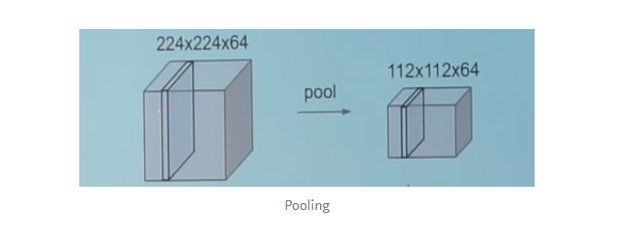
POOLING LAYER
Its function is to progressively reduce the spatial size of the representation to reduce the amount of parameters and computation in the network.
Figure 7: Pooling

Slide 20
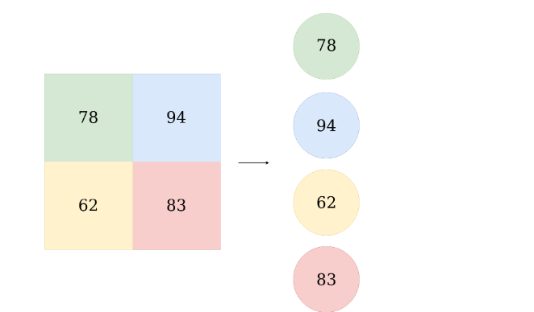
FULLY CONNECTED LAYER
The input to the fully connected layer is the output from the final Pooling or
Convolutional Layer, which is flattened and then fed into the fully connected layer.
Figure 8: Fully connected

Slide 21
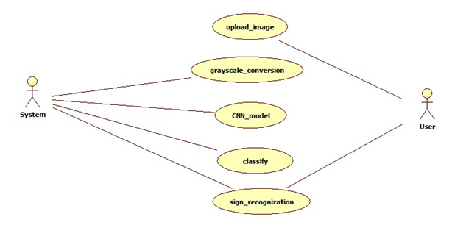
UNIFIED MODELLING LANGUAGE DIAGRAMS
Use Case Diagram for Traffic sign recognization
Figure 9: Use Case Diagram

Slide 22
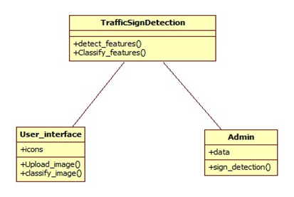
Class Diagram for Traffic Sign recognization
Figure 10: Class Diagram

Slide 23
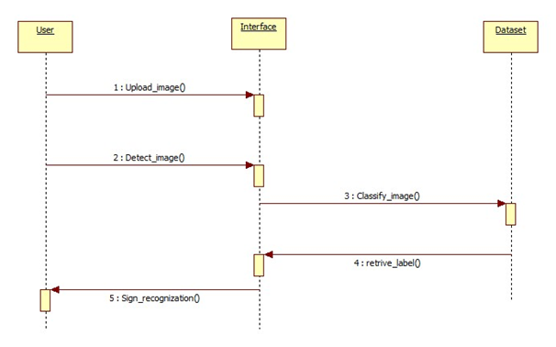
Sequence Diagram for Traffic Sign recognization
Figure 11: Sequence Diagram

Slide 24
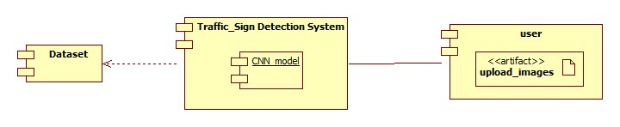
Component Diagram for Traffic Sign recognization​
Figure 12: Component Diagram

Slide 25
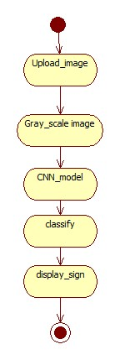
Activity Diagram for Traffic Sign recognization
Figure 13: Activity Diagram

Slide 26
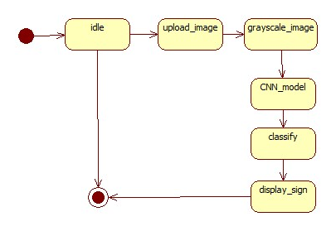
State Chart Diagram for Traffic Sign recognization
Figure 14: State Chart Diagram

Slide 27
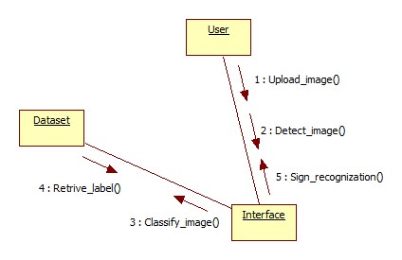
Collaboration Diagram for Traffic Sign recognization
Figure 15: Collaboration Diagram

Slide 28
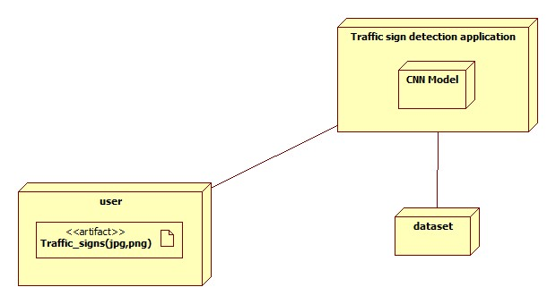
Deployment Diagram for Traffic Sign recognization
Figure 16: Deployment Diagram

Slide 29
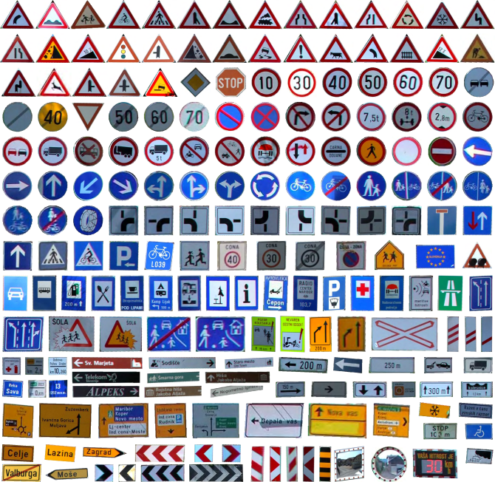
IMPLEMENTATION AND RESULT
GTSRB Dataset
The GTSRB dataset used in many systems for literature review and described briefly. For effective comparison of classification systems a dataset is employed.
Originally utilized in a multi-class single image classification competition, many authors now make use of the dataset for training and testing.
Figure 17 : GTSRB Dataset

Slide 30
FOR TRAINING A NEURAL NETWORK MODEL​
LOSS
A loss function is simple.It's a method for evaluating how well your algorithm models your dataset.
Optimizer
It is used to train the neural network by optimizing the cost function

Slide 31
FOR TESTING A NEURAL NETWORK MODEL​​
Epoch
The training process will run for a fixed number of iterations through the dataset called epochs.
Batch
A Batch as a for-loop iterating over one or more samples and making predictions.
Evaluate
The evaluate() function will return a list of two values. First is loss, Second is accuracy

Slide 32
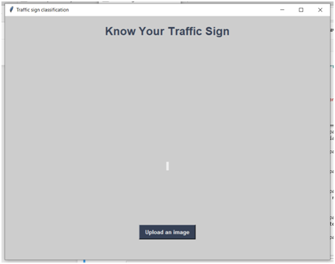
Interface of Traffic Sign Detection
Figure 18 : Output Screen 1

Slide 33
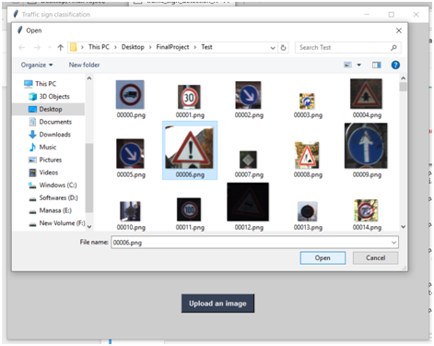
Input an Image
Figure 19 : Output Screen 2

Slide 34
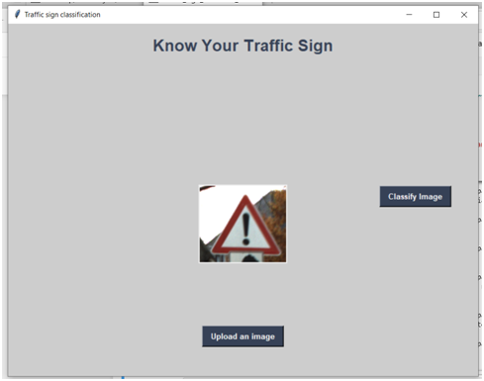
Selected image is displayed
Figure 20 : Output Screen 3

Slide 35
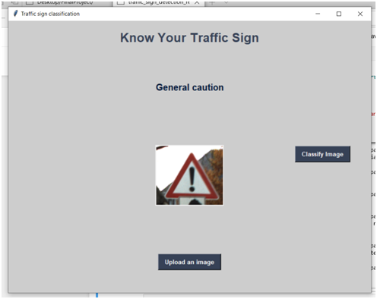
Final Output along with speech
Figure 21 : Output Screen 4

Slide 36
CONCULSION
The CNN model works very efficiently by degrading the complex steps into multiple layers. In our process the image which is identified even in adverse situations is solved with ease using CNN Model. The image which is taken as input is reduced in the form of multiple layers which in turn reduces the complexity of the system and our effort. The activation functions ReLU and the Softmax increases the capability and efficiency of the system in a great way.

Slide 37

ANY QUERIES

Slide 38
THANK YOU

